Slide 1




Grandparent
v1.0
Parent
Child

Slide 2
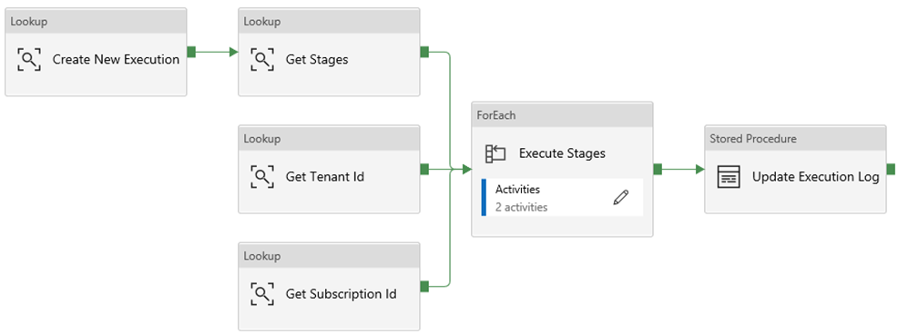
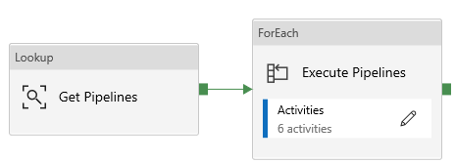
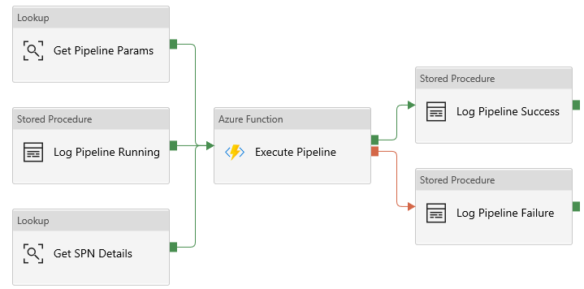
Grandparent
v1.1
Parent
Child

Slide 3
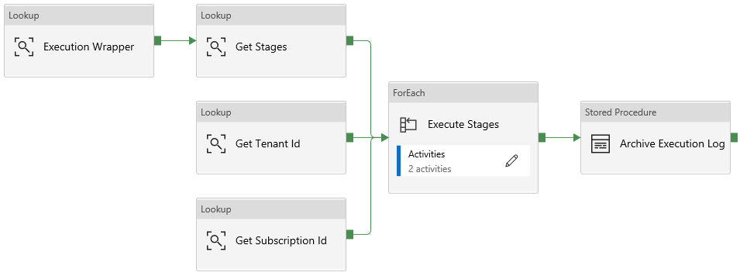


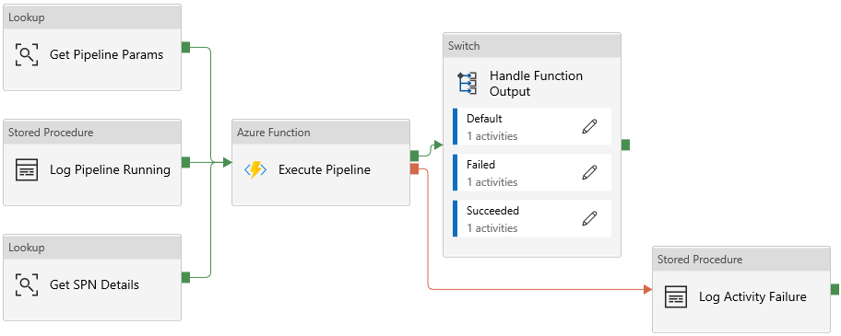
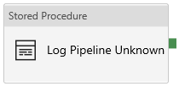
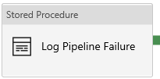
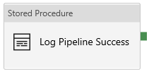
Grandparent
v1.2
Parent
Child
@{Case}

Slide 4

Grandparent
v1.3
Parent
Child
@{Case}

Slide 5
Success
Execute Pipeline
Fail
Complete
Skip

